Slide 1
SQA Plan
Instructor
Iqra Rafique
Lecturer
iqrarafique@cuilahore.edu.pk

Slide 2
The Process of Preparing an SQA Plan
The preparation of an SQAP is a systematic process that involves several steps to ensure the plan is comprehensive and aligned with the project's goals. The process typically includes:
Initiation and Planning:
  Define the scope and objectives of the SQAP.
  Identify stakeholders and their roles in the SQA process.
  Establish a timeline for the preparation and approval of the SQAP.

Slide 3
The Process of Preparing an SQA Plan
Gathering Requirements:
  Collect input from stakeholders, including project managers, developers, testers, and customers.
  Review project documentation, such as the Software Requirements Specification (SRS) and project plan.
Defining SQA Activities:
  Identify the SQA activities to be performed, such as reviews, testing, audits, and process evaluations.
  Determine the tools, techniques, and methodologies to be used.

Slide 4
The Process of Preparing an SQA Plan
Assigning Responsibilities:
  Assign roles and responsibilities for SQA activities to team members.
  Define the authority and accountability of the SQA team.
Documenting the SQAP:
  Prepare the SQAP document, ensuring it includes all necessary elements.
  Ensure the document is clear, concise, and aligned with organizational standards.

Slide 5
The Process of Preparing an SQA Plan
Review and Approval:
  Conduct a review of the SQAP with stakeholders to ensure completeness and accuracy.
  Obtain formal approval from relevant authorities.
Implementation and Maintenance:
  Distribute the approved SQAP to all stakeholders.
  Update the SQAP as needed throughout the project lifecycle to reflect changes in scope, requirements, or processes.

Slide 6
Key Elements of an SQA Plan (SQAP)
The SQAP is a comprehensive document that outlines the approach to ensuring software quality throughout the project lifecycle. According to Galin, the key elements of an SQAP include:
Purpose and Scope:
  Describes the purpose of the SQAP and its applicability to the project.
  Defines the scope of the SQA activities, including what is included and excluded.
Reference Documents:
  Lists the documents referenced in the SQAP, such as standards, guidelines, and project plans.

Slide 7
Key Elements of an SQA Plan (SQAP)
SQA Organization:
  Defines the organizational structure for SQA activities.
  Identifies roles, responsibilities, and reporting lines.
SQA Tasks and Responsibilities:
  Outlines the specific SQA tasks to be performed (e.g., reviews, testing, audits).
  Assigns responsibilities for each task to individuals or teams.
Standards, Practices, and Conventions:
  Specifies the standards, practices, and conventions to be followed during the project.
  Includes coding standards, documentation standards, and testing protocols.

Slide 8
Key Elements of an SQA Plan (SQAP)
Reviews and Audits:
  Describes the types of reviews and audits to be conducted (e.g., design reviews, code inspections, process audits).
  Defines the procedures, schedules, and participants for these activities.
Testing:
  Outlines the testing strategy, including unit testing, integration testing, system testing, and acceptance testing.
  Specifies the test environment, tools, and criteria for test completion.
Problem Reporting and Corrective Action:
  Defines the process for identifying, reporting, and resolving software defects and non-conformities.
  Includes procedures for tracking and verifying corrective actions.

Slide 9
Key Elements of an SQA Plan (SQAP)
Tools, Techniques, and Methodologies:
  Lists the tools, techniques, and methodologies to be used for SQA activities.
  Includes configuration management tools, testing tools, and process improvement methodologies.
Risk Management:
  Identifies potential risks to software quality and outlines mitigation strategies.
  Includes risk assessment, monitoring, and control procedures.
Training:
  Describes the training requirements for team members involved in SQA activities.
  Includes plans for training on tools, standards, and processes.

Slide 10
Key Elements of an SQA Plan (SQAP)
Documentation Control:
  Defines the procedures for controlling project documentation, including version control and change management.
Supplier Control:
  Outlines the procedures for ensuring the quality of software components supplied by third-party vendors.
Records Collection, Maintenance, and Retention:
  Describes the types of records to be maintained (e.g., test results, audit reports).
  Specifies the procedures for storing, maintaining, and retaining these records.

Slide 11
Key Elements of an SQA Plan (SQAP)
Metrics and Measurement:
  Defines the metrics to be used for measuring software quality (e.g., defect density, test coverage).
  Includes procedures for collecting, analyzing, and reporting these metrics.
SQA Plan Maintenance:
  Describes the procedures for updating and maintaining the SQAP throughout the project lifecycle.

Slide 12
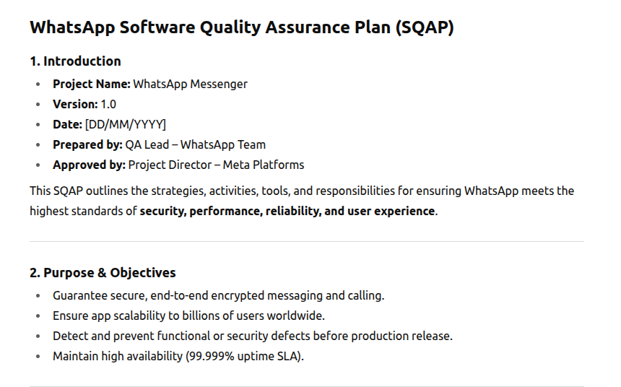
WhatsApp SQAP

Slide 13
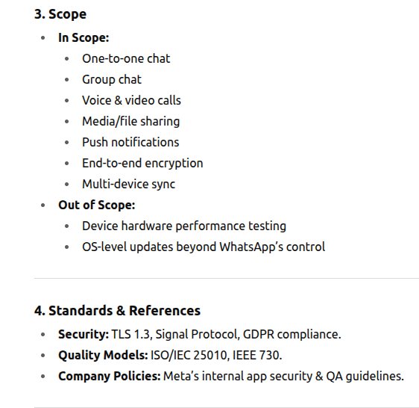

Slide 14
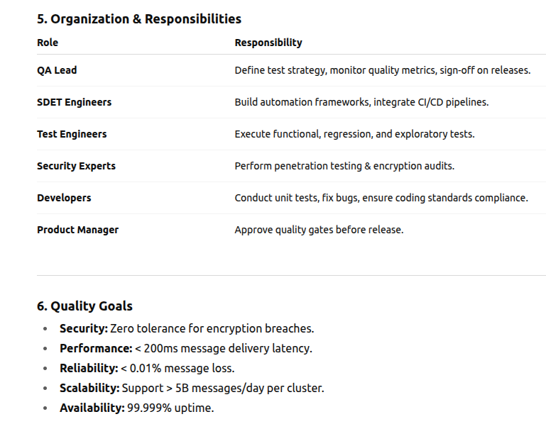

Slide 15
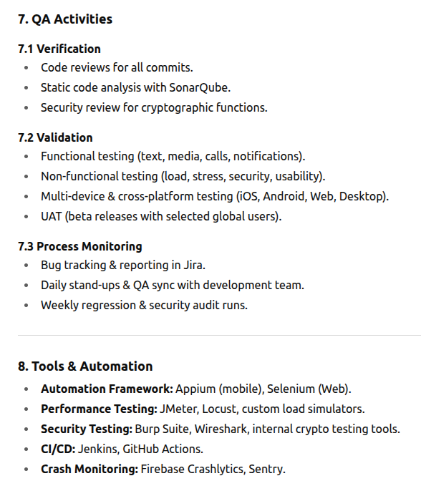

Slide 16
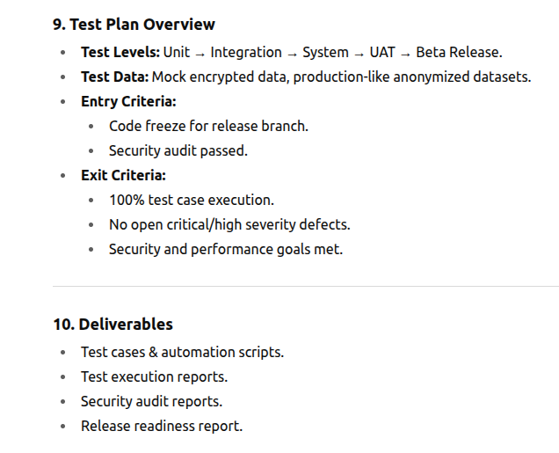

Slide 17
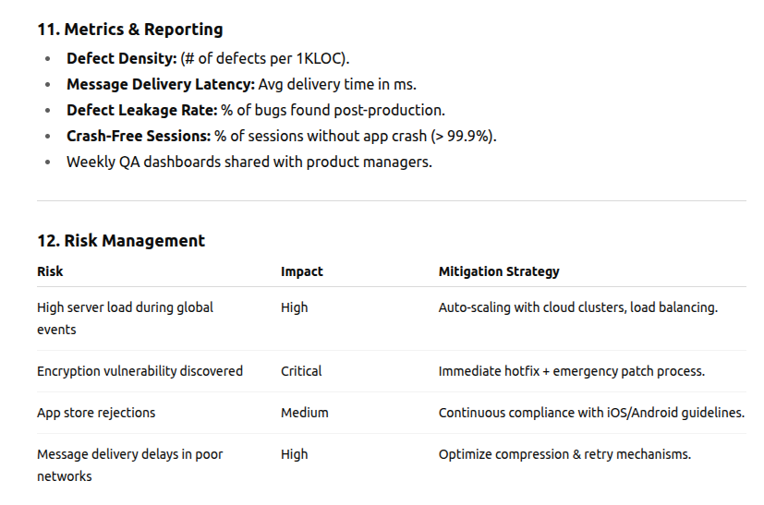

Slide 18


